Slide 1

AASD 4000
Machine Learning - I
Applied AI Solutions Developer Program

Slide 2
Module 07 Data Preprocessing
Vejey Gandyer

Slide 3
Agenda
Data Preprocessing
Importance of Data Preprocessing
Feature Scaling
Feature Standardization
Feature Normalization
Label Encoding
One Hot Encoding
Imputation
Task: Data Preprocessor

Slide 4
Data Preprocessing
What is it?

Slide 5
What is Data Preprocessing ?
Data Preprocessing is a technique that is used to convert the raw data into a clean data set.
Real-world data: Incomplete, inconsistent, and/or lacking in certain behaviors or trends, and is likely to contain many errors

Slide 6
What is Data Preprocessing ?
Rescaling
Mean Removal
Standardization
Normalization
One Hot Encoding
Binarization
Raw data
Clean data
Imputation

Slide 7
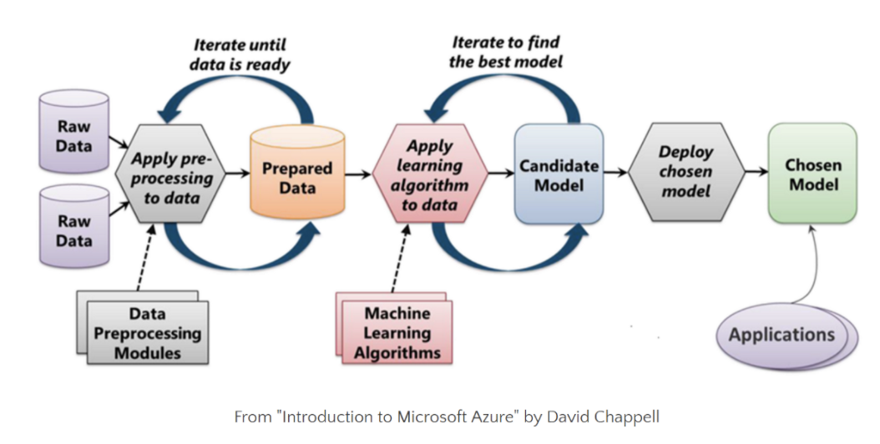
Machine Learning Process

Slide 8
Importance of Data Preprocessing
Why it is needed?

Slide 9
Importance of Data Preprocessing
Most of the time, we don’t get quality data.
Data
- Missing
- Noisy
- Inconsistent values
These can potentially reduce the accuracy of the model

Slide 10
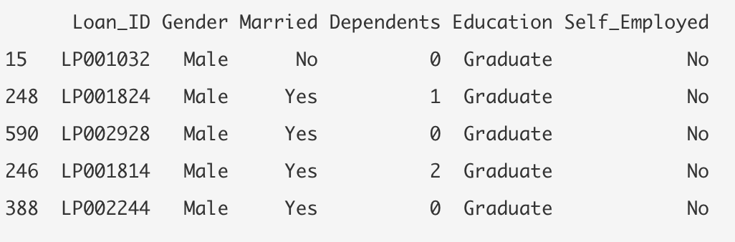
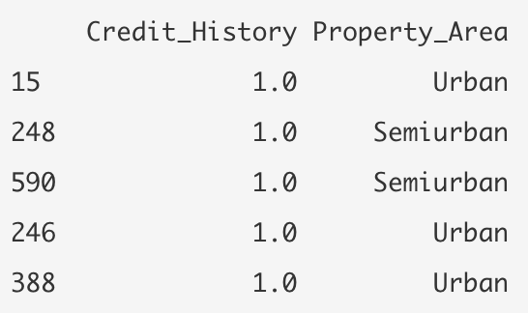
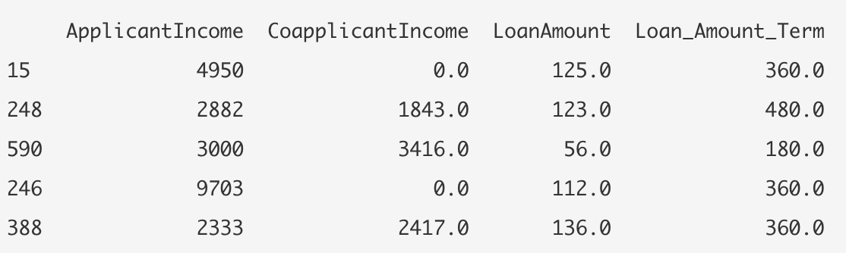
Dataset – Loan Prediction dataset
https://github.com/subashgandyer/datasets/blob/main/loan_prediction.zip

Slide 11
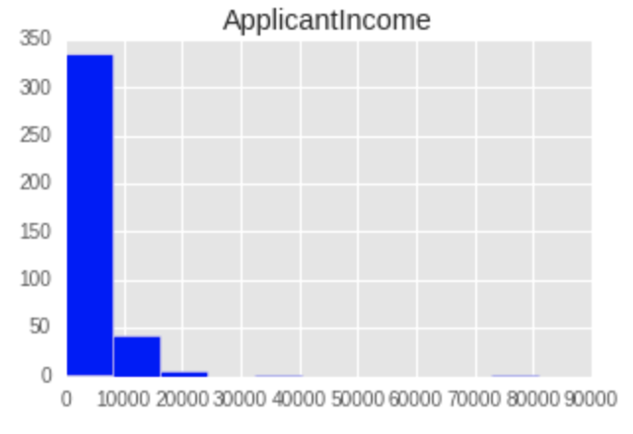
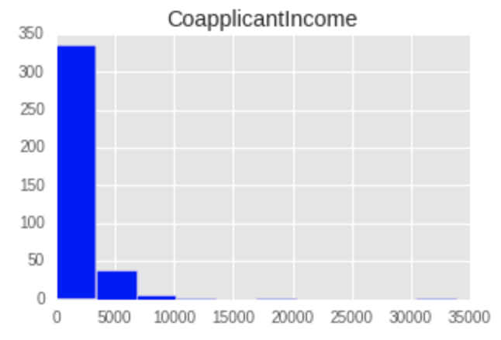
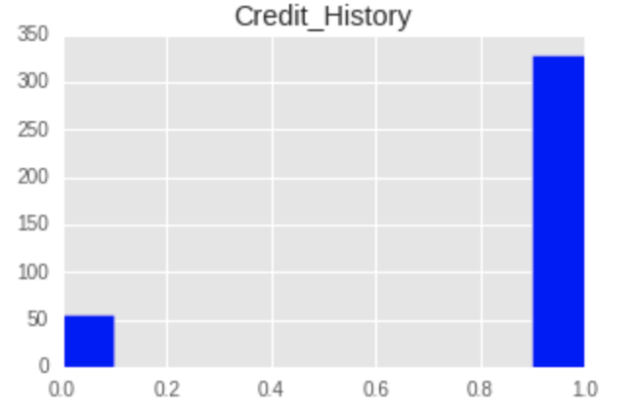
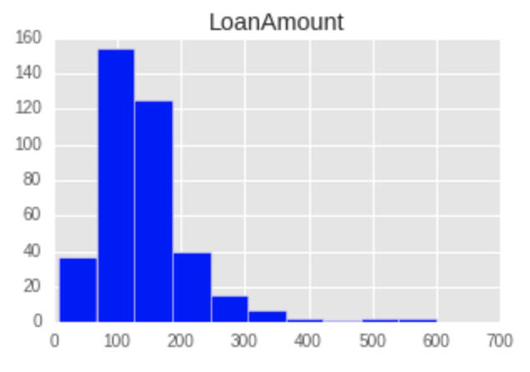
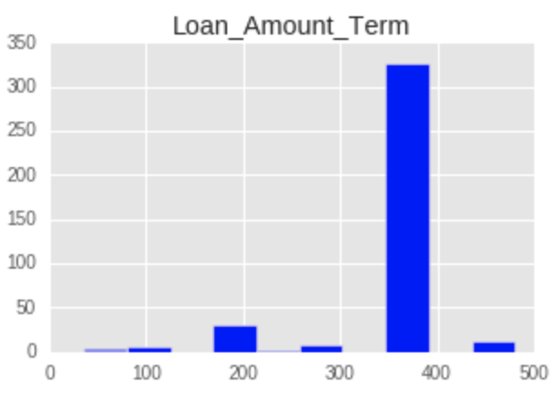
Dataset – Loan Prediction dataset

Slide 12
Feature Scaling

Slide 13
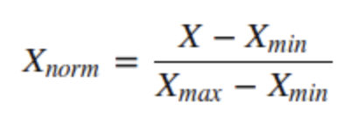
MinMaxScaler
Scales down all the features to a same range between 0 and 1

Slide 14
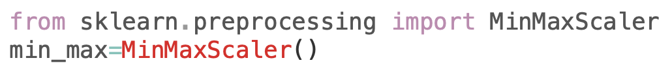
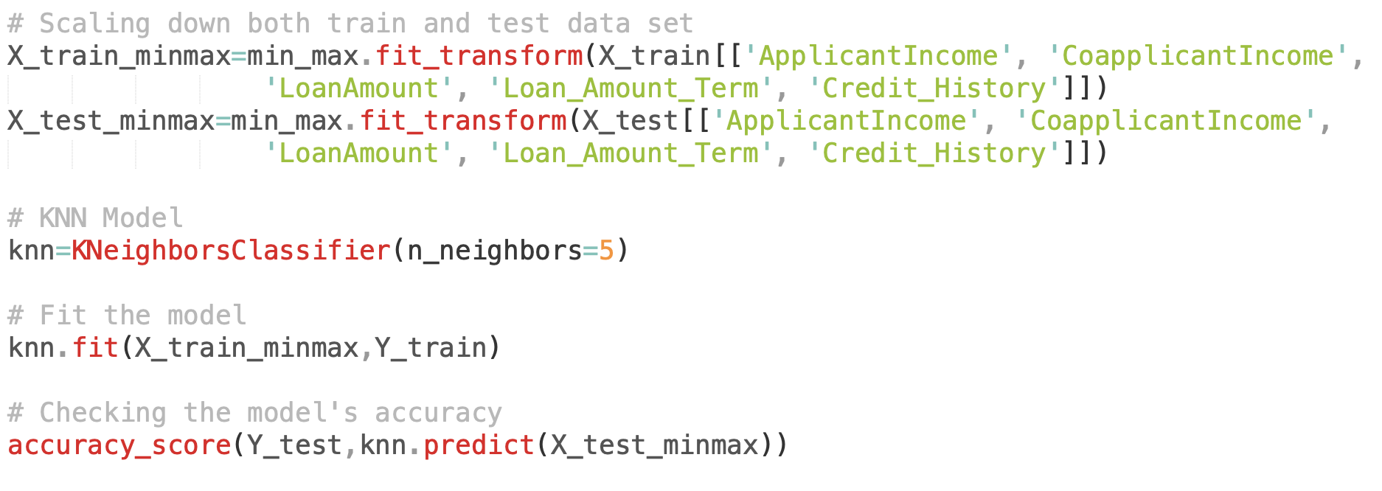
MinMaxScaler

Slide 15
Exercise: Build a Feature Scaler for Logistic Regression model
Use the previous code scripts in creating a Feature Scaler tool for Logistic Regression model
https://github.com/subashgandyer/datasets/blob/main/loan_prediction.zip

Slide 16
Feature Standardization

Slide 17
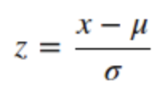
scale() - Feature Standardization
Scales down all the features to a standard normal distribution with zero mean and one Standard deviation

Slide 18
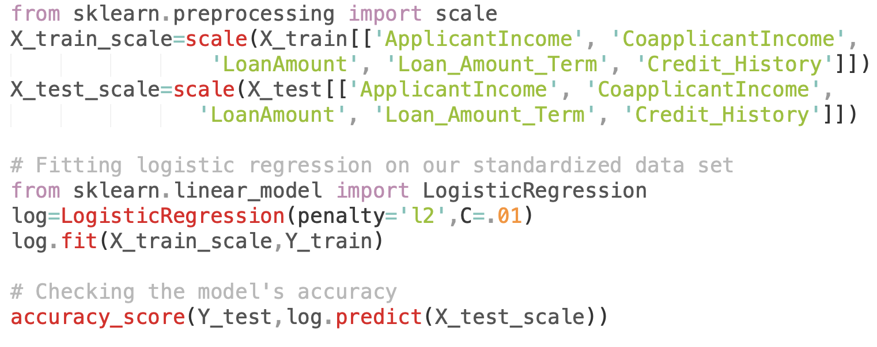
scale

Slide 19
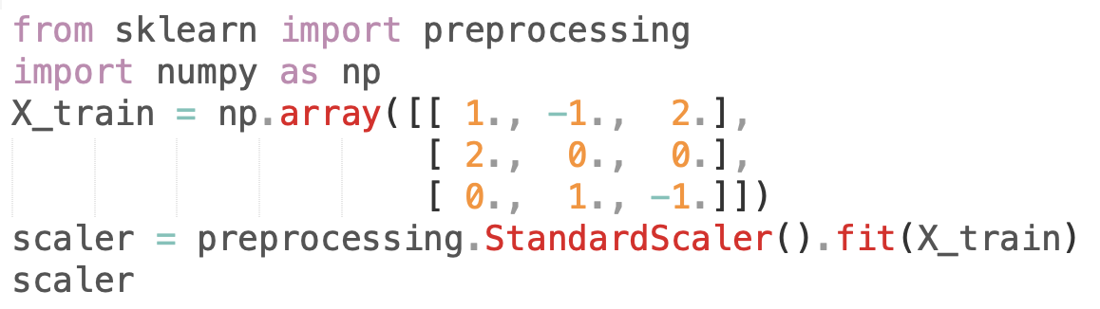
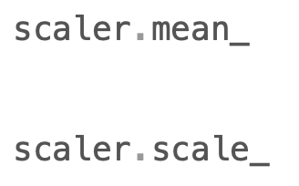
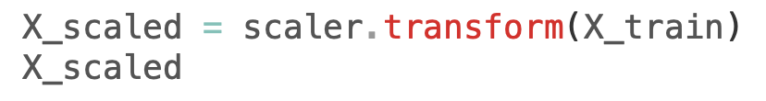
StandardScaler

Slide 20
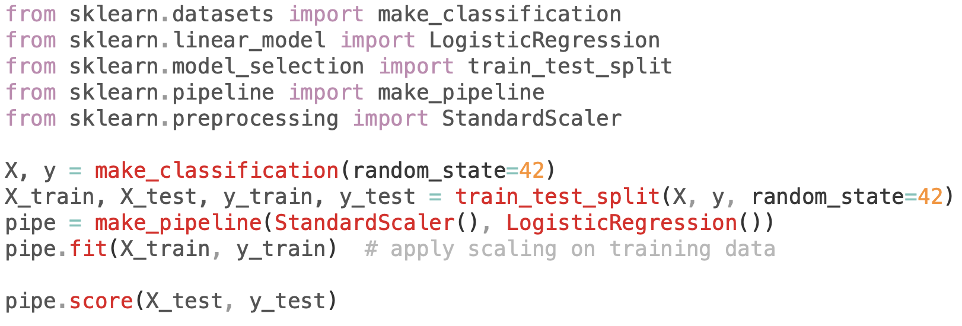
Pipeline

Slide 21
Exercise: Build a Feature Scaler for Support Vector Machine model
Use the previous code scripts in creating a Feature Scaler tool for Support Vector Machine model
https://github.com/subashgandyer/datasets/blob/main/loan_prediction.zip

Slide 22
Feature Normalization

Slide 23
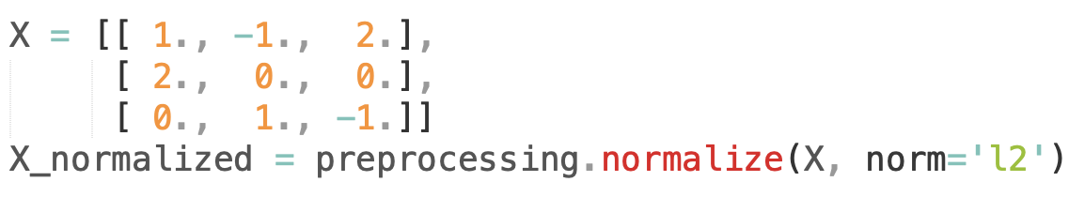
Normalization
Normalization is the process of scaling individual samples to have unit norm.
This process can be useful if you plan to use a quadratic form such as the dot-product or any other kernel to quantify the similarity of any pair of samples.

Slide 24
Categorical Variables

Slide 25
Label Encoding

Slide 26
Label Encoding
Categorical features should be transformed into numerical values
ML models need numeric arrays as inputs not strings
LabelEncoder encodes labels with value between 0 and n_classes – 1 with respect to alphabetical order

Slide 27
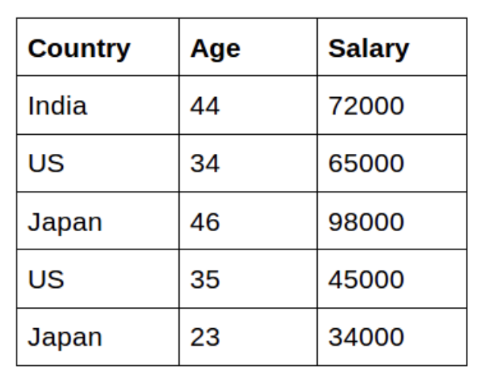
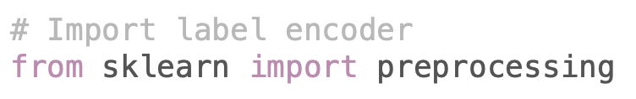
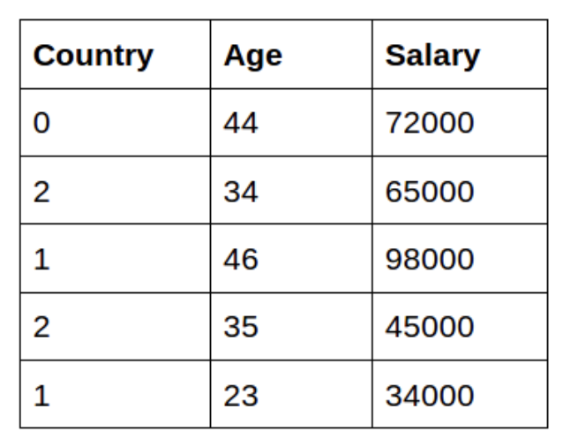
Label Encoding
Challenges:
India < Japan < USA

Slide 28
Exercise: Build a Label Encoding Preprocessing task
https://github.com/subashgandyer/datasets/blob/main/loan_prediction.zip

Slide 29
One-hot Encoding

Slide 30
One-hot Encoding
Transforms each categorical feature with n possible values into n binary features with only one active

Slide 31
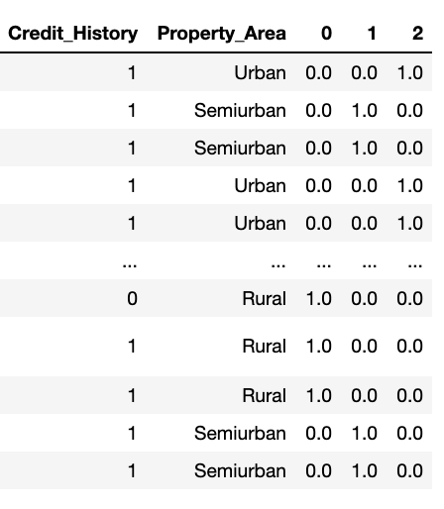
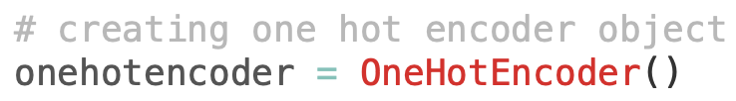
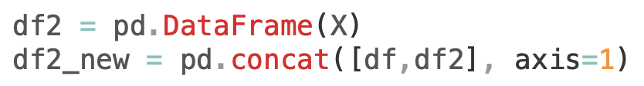
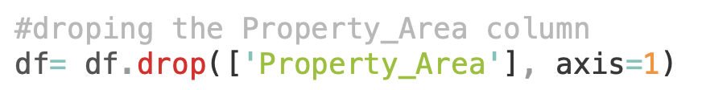
One-hot Encoding

Slide 32
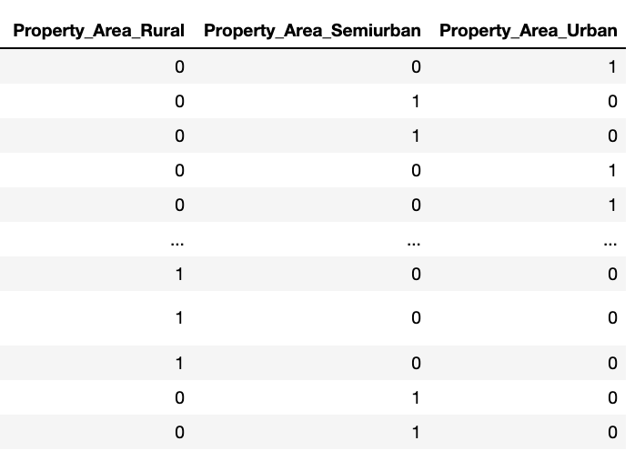
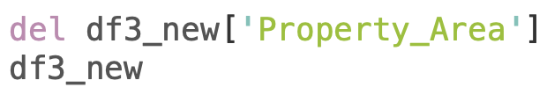
One-hot Encoding - get_dummies

Slide 33
Exercise: Build a One Hot Encoding Preprocessing task
https://github.com/subashgandyer/datasets/blob/main/loan_prediction.zip

Slide 34
Data Preprocessing
Hands-on

Slide 35
Data Preprocessing Task
Dataset: simple toy data with 10 entries
https://github.com/subashgandyer/datasets/blob/main/raw_data.csv
Data Dictionary:
Country - Country of Origin
Age - Age of the customer
Salary - Salary of the customer
Married - Marital Status
Create a fresh Python Notebook and follow along the simple data preprocessing (categorical features, missing values) process.

Slide 36
Imputation

Slide 37
Imputation
Process of dealing with missing values
1. Discard entire rows or columns containing missing values
2. Impute (infer them from the known part of the data) the missing values
Univariate Imputation - SimpleImputer
Multivariate Imputation - IterativeImputer

Slide 38
Univariate Imputation - SimpleImputer
Missing values can be imputed from
- a constant value
- statistics (mean, median, …)
https://github.com/subashgandyer/datasets/blob/main/heart_disease.csv

Slide 39
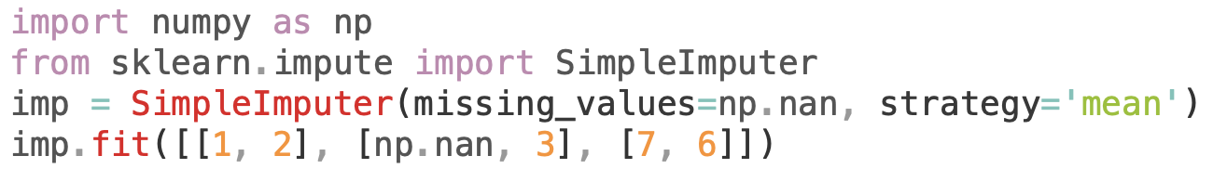
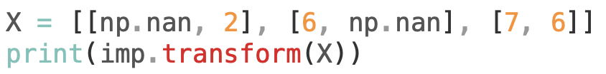
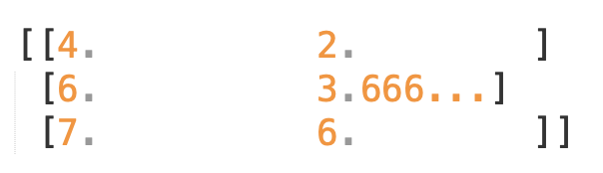
Univariate Imputation - SimpleImputer

Slide 40
Exercise: Build a SimpleImputer Preprocessing task
Assignment: In the same notebook, some are hands-on in-class exercises and the last portion is left as an assignment
https://github.com/subashgandyer/datasets/blob/main/heart_disease.csv

Slide 41
Multivariate Imputation - IterativeImputer
Models each feature with missing values as a function of other features, uses that estimate for imputation
Iterative approach:
At each step, one feature column is designated as output y and other features are treated as inputs X
A regressor is fit on (X, y) for known y
Regressor model is used to predict the missing values of y
Repeat the above steps until all features are considered and for max_iter repetitions

Slide 42
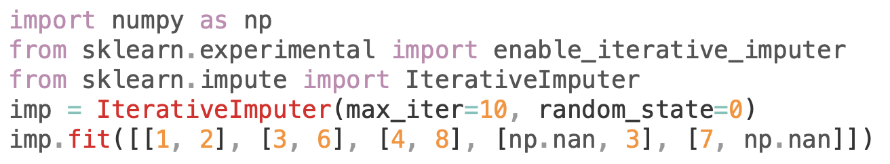
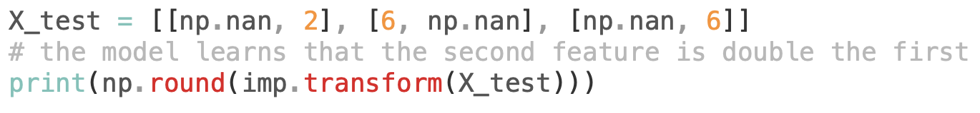
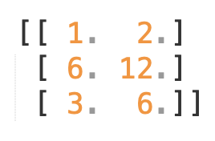
Multivariate Imputation - IterativeImputer

Slide 43
Exercise: Build a IterativeImputer Preprocessing task
https://github.com/subashgandyer/datasets/blob/main/heart_disease.csv

Slide 44
Discretization

Slide 45
Discretization
Quantization or Binning provides a way to partition continuous features into discrete values

Slide 46
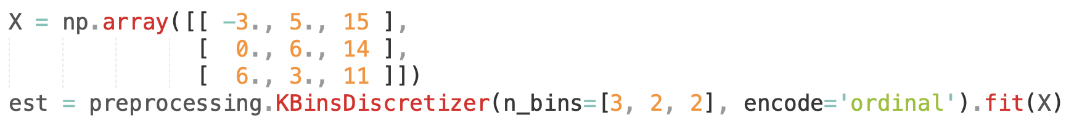
KBinsDiscretizer
Discretizes features into k bins

Slide 47
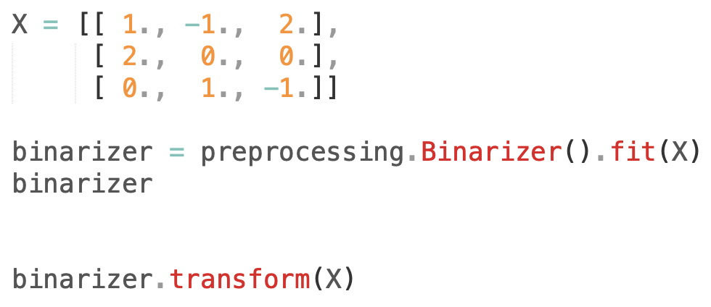
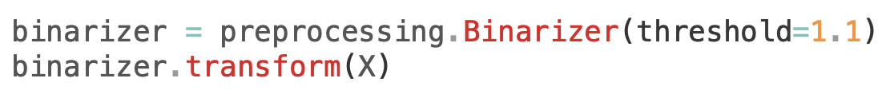
Binarization
Process of thresholding numerical features to get boolean values

Slide 48
Further Reading
Scikit-learn documentation
https://scikit-learn.org/stable/modules/impute.html#impute

